Slide 1
Chapter 7. Transmission Media
Guided Media
Unguided Media: Wireless

Slide 2
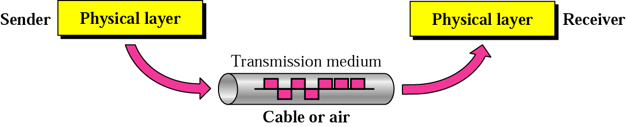


Transmission Medium & Physical Layer
7-<number>
Dr. Md. Abdur Razzaque
Green Networking Research Group
Dept. of Computer Science and Engineering, University of Dhaka

Slide 3

Classes of Transmission Media
7-<number>
Dr. Md. Abdur Razzaque
Green Networking Research Group
Dept. of Computer Science and Engineering, University of Dhaka

Slide 4

Twisted-pair Cable
7-<number>
Dr. Md. Abdur Razzaque
Green Networking Research Group
Dept. of Computer Science and Engineering, University of Dhaka

Slide 5

UTP and STP Cables
7-<number>
Dr. Md. Abdur Razzaque
Green Networking Research Group
Dept. of Computer Science and Engineering, University of Dhaka
Data Communications, Kwangwoon University

Slide 6
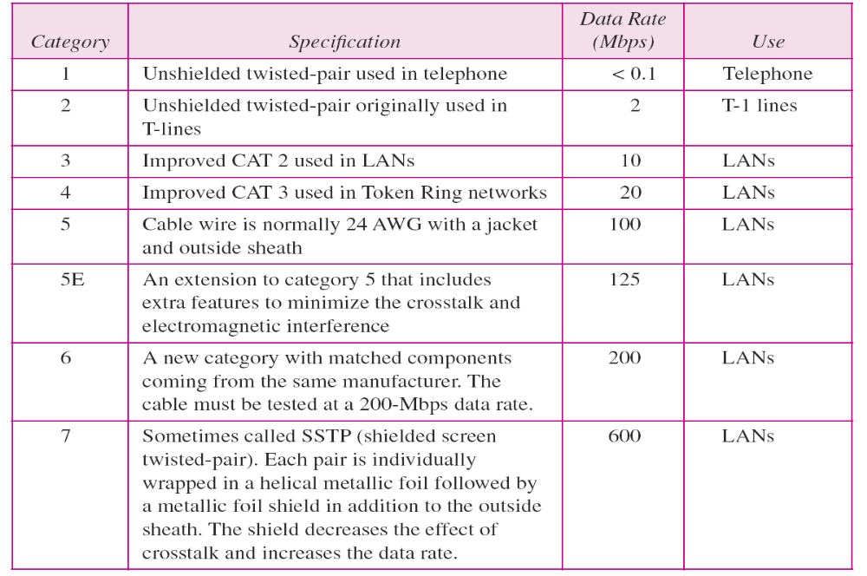
Categories of UTP Cables
7-<number>
Dr. Md. Abdur Razzaque
Green Networking Research Group
Dept. of Computer Science and Engineering, University of Dhaka

Slide 7


UTP Connector
7-<number>
RJ45 (RJ stands for registered jack)
Dr. Md. Abdur Razzaque
Green Networking Research Group
Dept. of Computer Science and Engineering, University of Dhaka

Slide 8

UTP Performance
7-<number>
Dr. Md. Abdur Razzaque
Green Networking Research Group
Dept. of Computer Science and Engineering, University of Dhaka

Slide 9
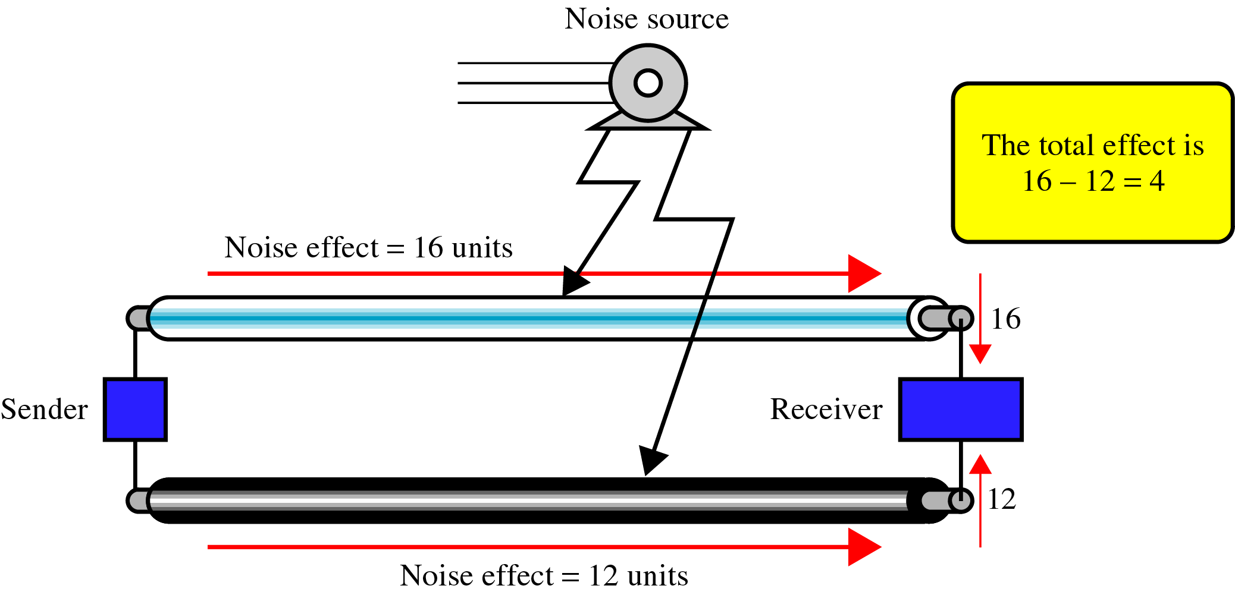
Parallel Flat Wire
7-<number>
Electromagnetic interference can create noise
The noise over parallel wires results in an uneven load and a damaged signal
Dr. Md. Abdur Razzaque
Green Networking Research Group
Dept. of Computer Science and Engineering, University of Dhaka

Slide 10
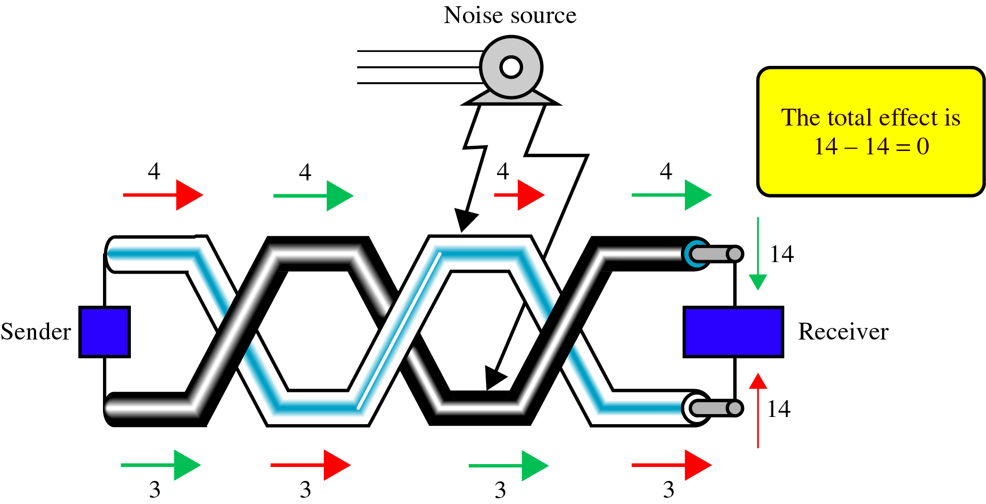
Noise Effect on Twisted-Pair
7-<number>
Cumulative effect of noise is equal on both sides
Twisting does not always eliminate the noise, but does significantly reduce it
Dr. Md. Abdur Razzaque
Green Networking Research Group
Dept. of Computer Science and Engineering, University of Dhaka

Slide 11
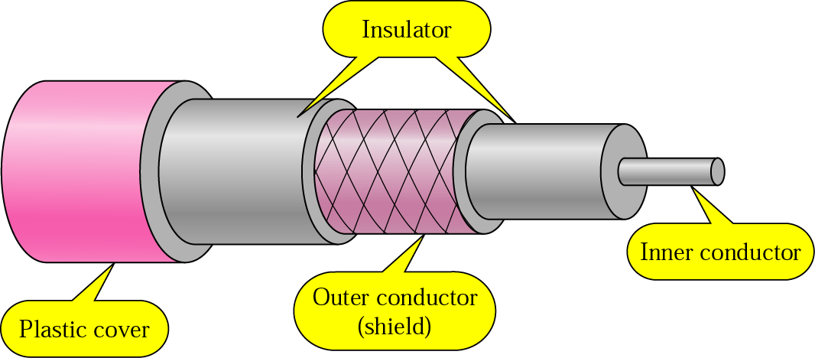
Coaxial Cable
7-<number>
Carries signals of higher frequency ranges than those in twisted-pair cable
Dr. Md. Abdur Razzaque
Green Networking Research Group
Dept. of Computer Science and Engineering, University of Dhaka

Slide 12

Categories of Coaxial Cables
7-<number>
Dr. Md. Abdur Razzaque
Green Networking Research Group
Dept. of Computer Science and Engineering, University of Dhaka

Slide 13

BNC Connectors
7-<number>
Bayone-Neil-Concelman (BNC) connector
Dr. Md. Abdur Razzaque
Green Networking Research Group
Dept. of Computer Science and Engineering, University of Dhaka

Slide 14

Coaxial Cable Performance
7-<number>
Dr. Md. Abdur Razzaque
Green Networking Research Group
Dept. of Computer Science and Engineering, University of Dhaka

Slide 15

Optical Fiber
7-<number>
Optical fiber is made of glass or plastic
It transmits signals in the form of light
The Nature of Light
The speed of light
  300,000 Km/sec in a vacuum
  Depends on the density of the medium through which it is traveling
Other properties of light
  Refraction, Critical angle, Reflection
Dr. Md. Abdur Razzaque
Green Networking Research Group
Dept. of Computer Science and Engineering, University of Dhaka

Slide 16
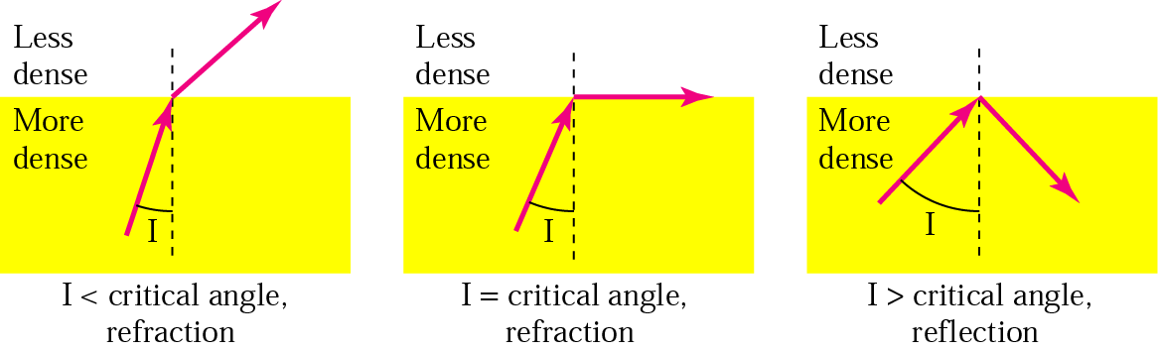
Bending of Light Ray
7-<number>
Dr. Md. Abdur Razzaque
Green Networking Research Group
Dept. of Computer Science and Engineering, University of Dhaka

Slide 17

Optical Fiber
7-<number>
Dr. Md. Abdur Razzaque
Green Networking Research Group
Dept. of Computer Science and Engineering, University of Dhaka

Slide 18
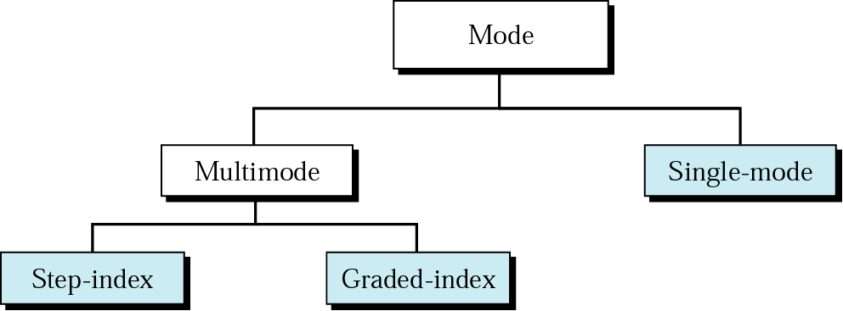
Propagation Modes
7-<number>
Dr. Md. Abdur Razzaque
Green Networking Research Group
Dept. of Computer Science and Engineering, University of Dhaka

Slide 19

Modes
7-<number>
Dr. Md. Abdur Razzaque
Green Networking Research Group
Dept. of Computer Science and Engineering, University of Dhaka

Slide 20
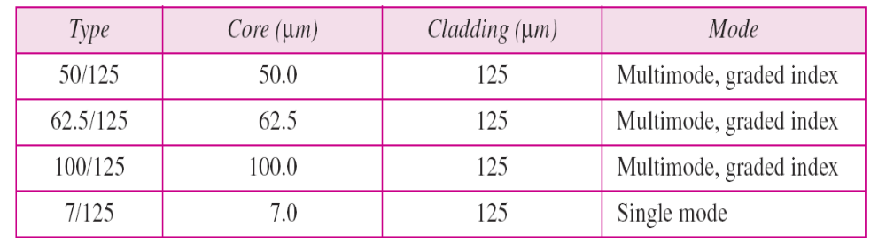
Fiber Types
7-<number>
Dr. Md. Abdur Razzaque
Green Networking Research Group
Dept. of Computer Science and Engineering, University of Dhaka

Slide 21

Fiber Construction
7-<number>
Dr. Md. Abdur Razzaque
Green Networking Research Group
Dept. of Computer Science and Engineering, University of Dhaka

Slide 22

Fiber-optic Cable Connectors
7-<number>
SC (subscriber channel) connector used for cable TV. It uses push/pull locking system
ST (straight-tip) connector used for connecting cable to networking device. It uses a reliable bayonet locking system
MT-RJ is the same size as RJ45
Dr. Md. Abdur Razzaque
Green Networking Research Group
Dept. of Computer Science and Engineering, University of Dhaka

Slide 23

Optical Fiber Performance
7-<number>
Dr. Md. Abdur Razzaque
Green Networking Research Group
Dept. of Computer Science and Engineering, University of Dhaka

Slide 24
Advantages/Disadvantages of Optical Fiber
7-<number>
Advantages
  Higher bandwidth
  Less signal attenuation
  Immunity to electromagnetic interference
  Resistance to corrosive materials
  Light weight
  Greater immunity to tapping
Disadvantages
  Installation and maintenance
  Unidirectional light propagation
  Cost
Dr. Md. Abdur Razzaque
Green Networking Research Group
Dept. of Computer Science and Engineering, University of Dhaka

Slide 25
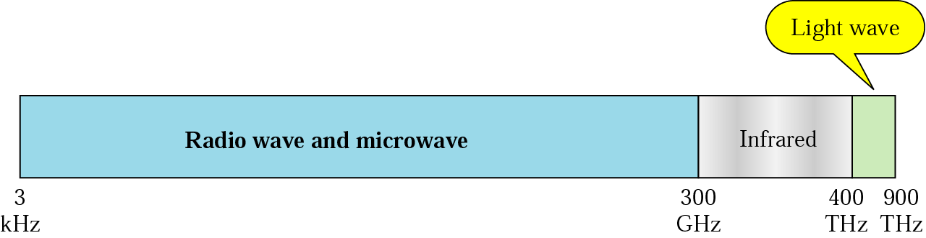
Electromagnetic Spectrum for wireless
7-<number>
Dr. Md. Abdur Razzaque
Green Networking Research Group
Dept. of Computer Science and Engineering, University of Dhaka

Slide 26
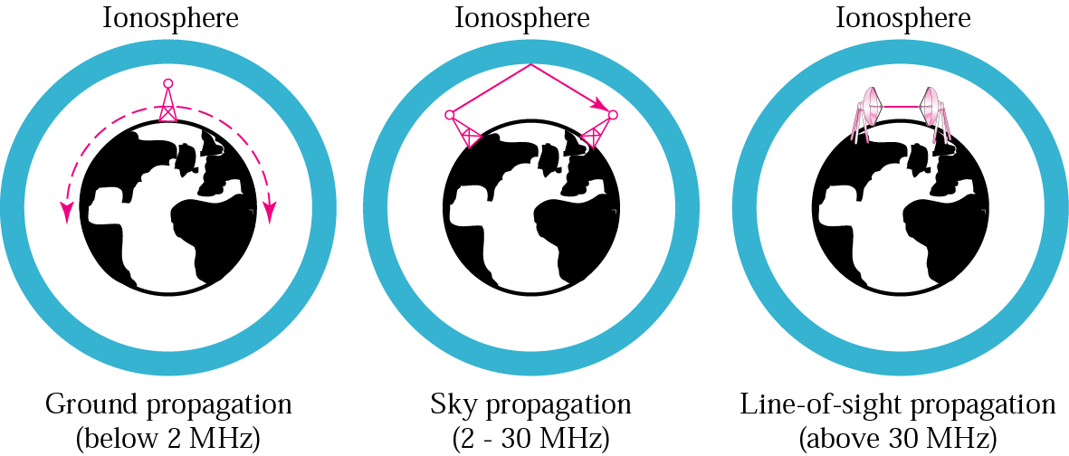
Propagation Methods
7-<number>
Dr. Md. Abdur Razzaque
Green Networking Research Group
Dept. of Computer Science and Engineering, University of Dhaka

Slide 27
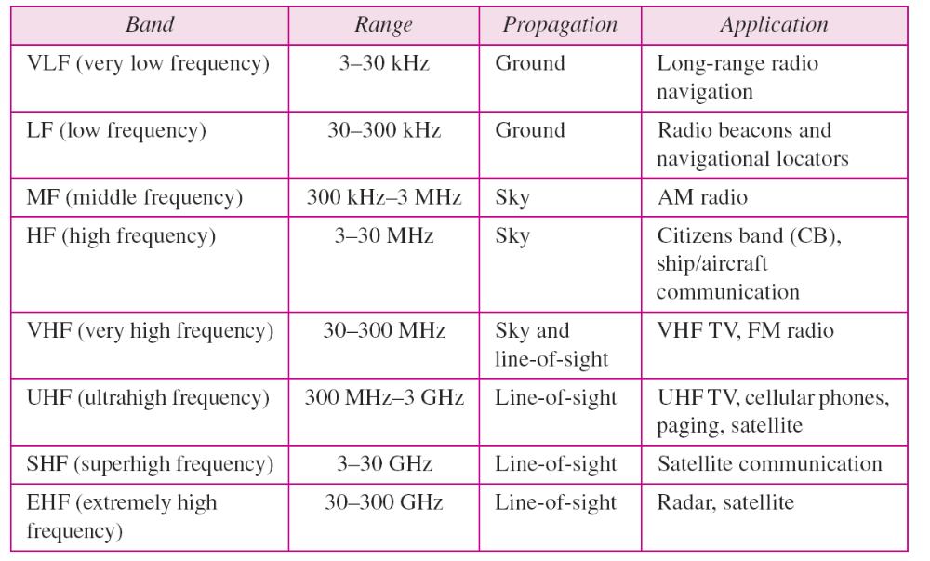
Bands
7-<number>
Dr. Md. Abdur Razzaque
Green Networking Research Group
Dept. of Computer Science and Engineering, University of Dhaka

Slide 28
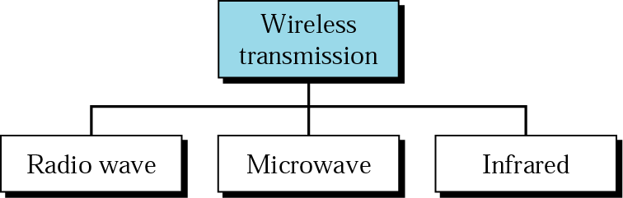
Wireless Transmission Waves
7-<number>
Dr. Md. Abdur Razzaque
Green Networking Research Group
Dept. of Computer Science and Engineering, University of Dhaka

Slide 29

Wireless Transmission Waves
7-<number>
Radio waves are used for multicast communications, such as radio and television, and paging systems
Microwaves are used for unicast communication such as cellular telephones, satellite networks, and wireless LANs
Infrared signals can be used for short-range communication in a closed area using line-of-sight propagation
Dr. Md. Abdur Razzaque
Green Networking Research Group
Dept. of Computer Science and Engineering, University of Dhaka

Slide 30
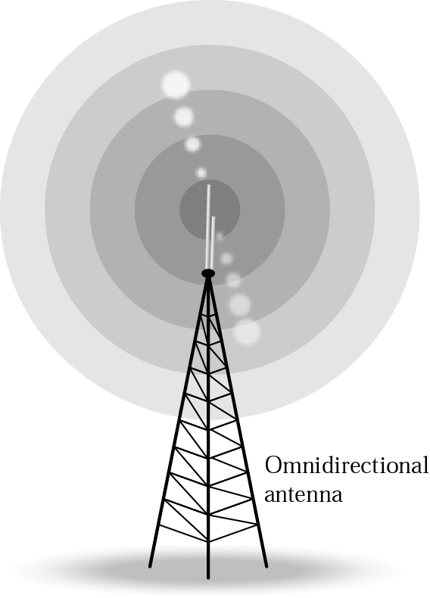
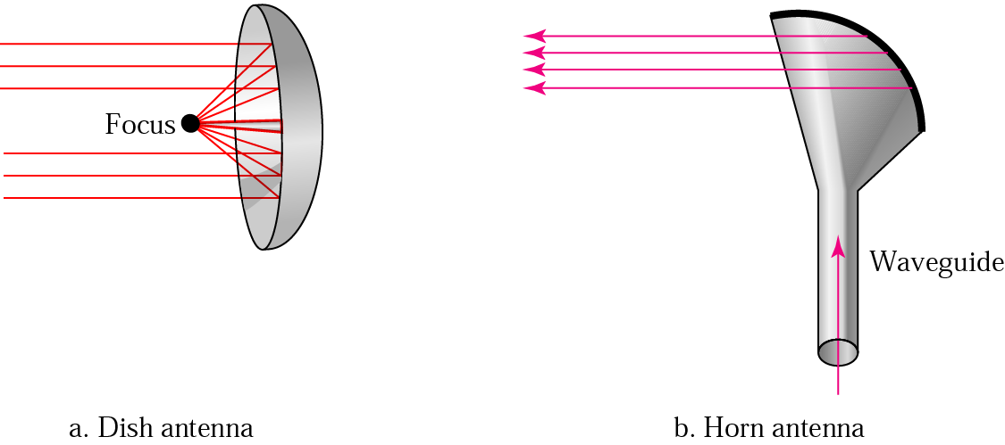
Omnidirectional & Unidirectional Antennas
7-<number>
Dr. Md. Abdur Razzaque
Green Networking Research Group
Dept. of Computer Science and Engineering, University of Dhaka

Slide 31
Infrared
7-<number>
Infrared waves with frequencies from 300 GHz to 400 THz for short-range communication in a closed area using line-of-sight propagation
Having high frequencies, it cannot penetrate walls
IrDA (Infrared Data Association) for standards
Example: IrDA port for wireless keyboard
  Originally defined a data rate of 75 kbps for a distance up to 8 m
  Recent standard for a data rate of 4 Mbps
Dr. Md. Abdur Razzaque
Green Networking Research Group
Dept. of Computer Science and Engineering, University of Dhaka

